Slide 1
Capstone project Mahindra first choice
Exploratory data analysis and machine learning
Greyatom capstone project
Contributors : Girish vankudre

Slide 2
About Data
Mahindra First Choice Services (MFCS) is a company of Mahindra Group and is India’s leading chain of multi-brand car workshops.
Mahindra would now like to leverage the data they have and gain insights to address the key issues they face.
The dataset consist of three aspects:
Customer Data: where the details of the customer like the car owned, state and place of residence, order type, etc are present. Data dimension is of 5,34,000 Customer entries.
Invoice Data: where information related to customer visits and transactions are recorded, whether a customer as insurance claims, bifurcation of the amount paid, for what type of service did the customer came for etc.
Material Inventory: where information related to what kind of service did the customer took and what kind of material was used to service, labour information and the cost for the service, Plant and plant name where the customer took the service.

Slide 3
Problem Statement 1 : Geological based customer analysis
Identifying the ownership pattern of cars throughout the country. This also captures the problem wherein information regarding the spending patterns can be identified
This way Mahindra First Choice Services will be benefited in multiple ways. Knowing the ownership pattern targeted marketing campaigns could be carried out. Knowing the spending patterns services could be suited to the particular spending pattern.

Slide 4

Problem Statement 1 : Geological based customer analysis
Car (Make) ownership distribution across the states
Either not enough data available for workshops located in NE Indian states/Hilly states (like J&K) or workshops in these states are operating very poorly in terms of attracting customer base or workshops could be poorly placed. In either way there is lot of work required to be done in terms of record management and exploring potential customer base and relocating the workshops at an advantageous location on case by case basis.
MFC as an entity could also look for partnership with other Car Makers to act as preferred partner in the areas where it is performing poorly and sees potential business. Thereby strategically placing itself in local market. (Potential partnership with Maruti Suzuki, Tata Motors, Hyundai)
Densely populated, economy drivers and tourism friendly states are showing good number of footfalls. So in these states vehicular presence seems to be more catering variety of customer base according to their income. (This observation could be backed by other sources of data pertaining to RTO vehicle registration per year in these states.)
Most of the variety in terms of car ownership (Make) is seen amongst the state of MH, TN, AP, HR, RJ PB, KA KE.
Premier car (Make) ownership is present in selected few states of MH, PB, TN, KA, GJ, MP, AP.

Slide 5
Problem Statement 1 : Geological based customer analysis
Revenue generation across the states
MH and TN are most revenue generating states from MFC perspective. This on the other way round could be seen as customers in these areas are more alert about car care and do not hesitate to visit workshop whenever essential.
A lot of potential is waiting to be tapped in all other states. Especially expansion towards NE, extreme North, central India. (This study could be backed by income-spending data for these states.)
Workshop expenditure on premier class cars at MFC is comparatively less basis available data.
In terms of revenue generation for MFC or spending of a customer basis car (Make) we could see majority of M&M, Maruti Suzuki, TATA Motors and Hyundai in most of the states.

Slide 6
Problem Statement 1 : Geological based customer analysis
Order Type distribution across the states basis season to build inventory
Not enough data available for J&K/NE States to conclude on. If improved on record keeping and data capturing, this will surely help on getting insights and serving customer needs of these area through MFC workshops.
In most of the states Running Repairs dominates the order type. After Running Repairs and Paid Services, Accident is one of the major reason for which customers visit MFC workshops.
For TN in the season 2012/13-Q2, we could people preferring Paid Services. The reason could be preparedness for some extreme weather or a natural calamity which has caused customers to go for paid service. Similar is the observation for MH in 2013-Q2/Q3, 2014-Q4, 2013-Q1, 2012-Q2/Q3.
KA is a state with consistent reporting Order Type for Accident. Reson could be higher density of vehicles on road or overall lack of traffic sense.

Slide 7
Problem Statement 1 : Geological based customer analysis
Season wise revenue trend across states
Data seems incomplete for the states of NE India and J&K.
For AP, TN and MH, it's a downward trend in terms of total revenue.
For GJ, Q1 to Q2 is upward trend and Q2 to Q3 to Q4 is downward trend. Trend is uniform in terms of pattern across 2014, 2015 and 2016.
For HR, 2016 Q1-Q2 and Q3 were most fruitful but trend experienced sudden fall towards 2016-Q4. There might be some reason for its rise at the start of 2016 and sudden fall at the end of 2016.
For KA, peak revenue was experienced once during 2015-Q2.
For KE, sudden drop from peak revenue was observed from 2014-Q4 to 2015-Q1.
For PB, peak revenue was experienced once during 2015-Q4 and then a sudden fall in 2016-Q1. There must be some reason.

Slide 8
Problem Statement 1 : Geological based customer analysis
Season wise customer count trend across states
Data seems incomplete for the states of extreme North and North East.
Most of the states shows downward trend in terms of customer footfall between 2016 Q3 to Q4.
Nagaland typically shows complete flat trend in during odd years (2013, 2015) but sudden increase in early quarters and sudden fall in late quarters of even years (2012, 2016).
State of Telangana, WB, UT, TN showing exponential growth from the late 2013 and touching their peak performance once till 2016-Q3.

Slide 9
Problem Statement 1 : Geological based customer analysis
Average spent per Make and Highest spent per Make across the states
Data seems incomplete for the states of extreme North and North East.
Average spent of premier class cars is comparatively high compared to other classes of cars in the states like Telangana, KL, KA, TN, HR, DL, PB, MH.
The potential is to ensure that positive experience of these premium customers is utilized to be marketed in the area to attract more such customers and frequency of their visits by providing them with premium services of regular vehicle check ups.
Rest other class of cars are contributing in terms of count but the large share of spent of these cars is small such that average spent is on lower side.
The data provides us insight in terms of Average Cost per Make and Highest Amount Spent per Make across the states.
This data would help MFC to build inventory of respective car spare parts in the state.

Slide 10
Problem Statement 2 : Market Segmentation
Customer Lifetime value prediction - Based on Customer segments, predict the revenue that can be extracted from each segment over a life of the car -Regression/Time Series.
This would be beneficial to Mahindra First Choice Services to identify the various segments in the market. Also, these segmentations would allow for targeted marketing activities and sales promotions.
Note: An important assumption we have made here is that, we are not considering repair works that has come due to accident. Rationale being, accidents are unpredictable. The data to predict whether a driver will commit an accident (with probability) is not currently available with us. Hence, removing accident related data from our analysis. But a separate analysis around accident cases would be beneficial to allied companies of Mahindra dealing in car finance and vehicle/life insurance.

Slide 11
Data processing steps for Segmentation and model building
Loading the data and treating null values
Identification and treatment of Outliers
Developing of features like Recency (Active/Inactive Days), Frequency (Number of visits), Monetary value (Total amount spent till date) and Mileage (Difference between average kilometers a car run in India and actual kilometers run)
Segmentation of Customers (High Value/Mid Value/Low Value) using K-means clustering
Understanding and treatment of data skewness
Handling of Categorical features
Building baseline model with Random Forest Regressor and evaluating the model with Accuracy and RMSE score

Slide 12
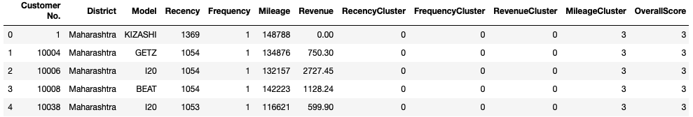
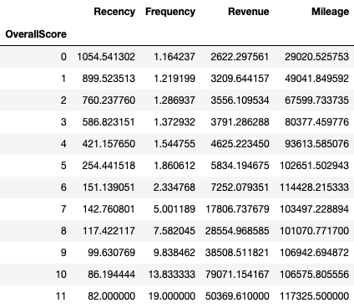
Customer segmentation basis Recency, frequency and monetary value and Mileage
Low Value (0-5): Customers who are less active than others, not very frequent buyer/visitor and generates very low - zero - maybe negative revenue. Even these customers have reached closer to a Mileage covered by an Indian car in it’s lifetime.
Mid Value (6-8): In the middle of everything. Often using our workshop (but not as much as our High Values), fairly frequent and generates moderate revenue. The car also recorded fair amount of Mileage.
High Value (9-11): The group we don’t want to lose. High on Revenue & Frequency but low on Inactivity & Mileage.

Slide 13
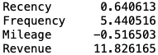
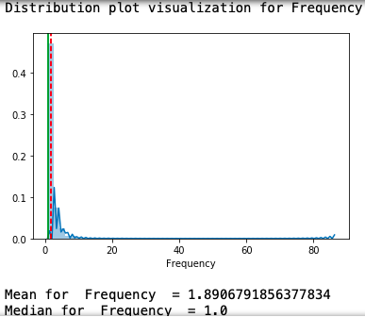
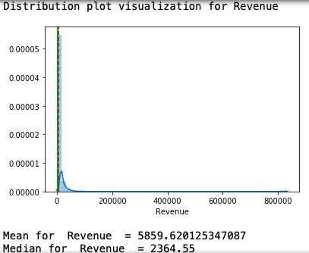
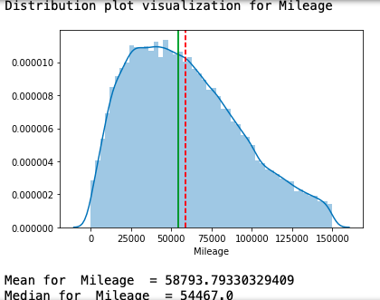
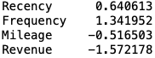
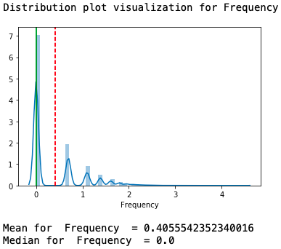
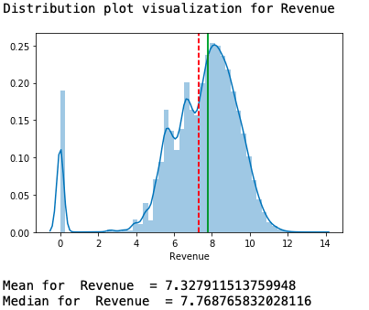
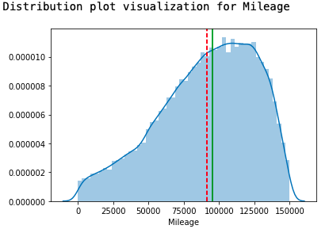
Understanding and treatment of data skewness
Before skewness correctio (Frequency and Revenue)
Right/Positive skewness correction with Log Transformation

Slide 14
Handling too many categorical values – Feature Hashing
As the year progresses, there is a fair chance of old car models getting discarded and new car models getting added.
To address this issue, instead of using conventional method of Label Encoding or One Hot Encoding, we have used Feature Hashing library of sklearn.
The feature hashing scheme is useful feature engineering scheme for dealing with large scale categorical features. In this scheme, a hash function is used with the number of encoded features pre-set (as a vector of pre-defined length) such that the hashed values of the features are used as indices in this pre-defined vector and values are updated accordingly.
Thus even if we have over 100 distinct categories in a feature and we set bins equal to 10 as the final feature vector size, the output feature set will still have only 10 features as compared to 100 binary features if we used a one-hot encoding scheme.
This will ensure that we limit the dimensionality of our features as well as not missing out on ever changing car make.

Slide 15
Building baseline model with Random Forest Regressor
One of the important business strategy is the ability to predict potential revenue a customer can generate for the business over a period of time. It is with this intention we try to predict ’Revenue’ feature for a customer basis it’s historical data like number of inactive days, number of times customer has visited the workshop, total amount spent till date and the total kilometers a car has travelled.
Training a model with seen data (Year 2012 to Year 2015)
Testing a model with unseen data (Year 2016)

